Slide 1


Bioinformatic Analysis of RNA Sequencing Data to Identify Significant Genes for Tuberculosis in Type 2 Diabetes Mellitus Comorbidity
HARISANKAR D
Reg. No. 21378016
MS Bioinformatics
SUPERVISED BY
Dr. Ramdas Krishna
Department of Bioinformatics
Pondicherry University

Slide 2
Introduction
Tuberculosis (TB) is an airborne infectious disease caused by Mycobacterium tuberculosis
Occurs in two phases : LTBI and ATB
Occurs frequently in people who are immunosuppressed
T2DM is a chronic metabolic disorder characterized by hyperglycemia. It is caused by a combination of genetic and environmental factors, such as obesity, and recently there has been a sharp increase in T2DM-ATB comorbidity
Early detection of ATB in such individuals is necessary in order to have better treatment outcome

Slide 3
Objectives
To identify common Differentially Expressed Genes between TB only and TBDM comorbid groups
To perform functional enrichment and network analysis for the resulted DEGs and identify hub genes
To find Micro-RNAs that target these hub genes

Slide 4
Methodology
Place : Cape Town (SA)
Median Age : 40
Groups | Sample Number
TB only | 7
DM only | 7
TBDM comorbid | 7
Healthy Control | 7

Slide 5
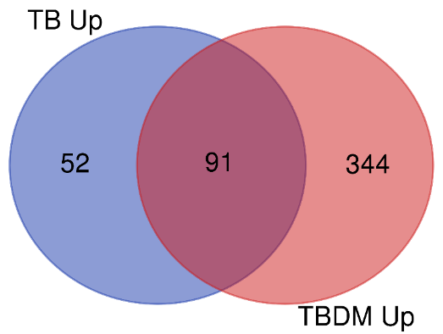
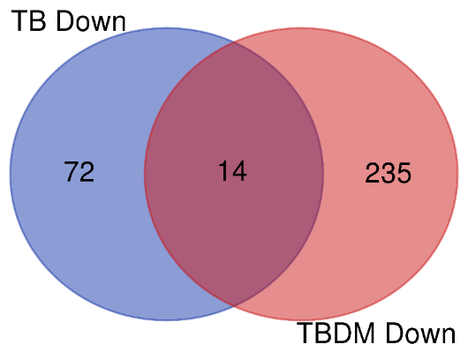
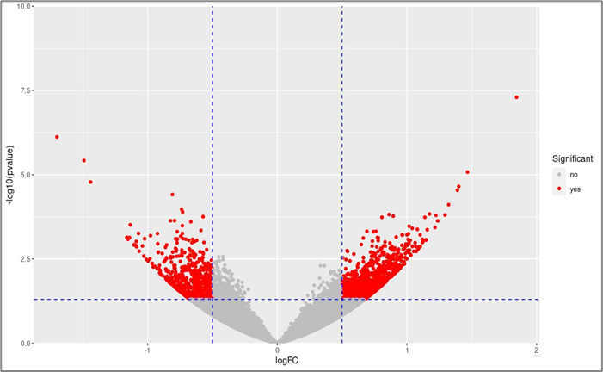
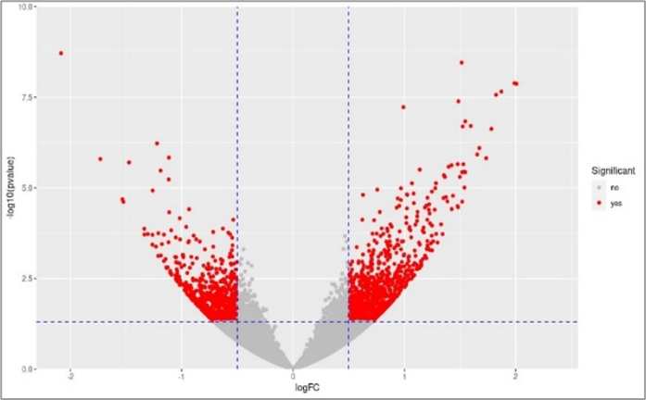
Common DEGs between TB only and TBDM comorbid groups
Results
Total 105 Common DEGs
Volcano Plots
cut-off : p-value < 0.01
TB only
TBDM comorbid

Slide 6
Functional Enrichment Analysis
Biological Process
cut-off : p-value < 0.05

Slide 7
Pathway Enrichment Analysis
cut-off : p-value < 0.05

Slide 8
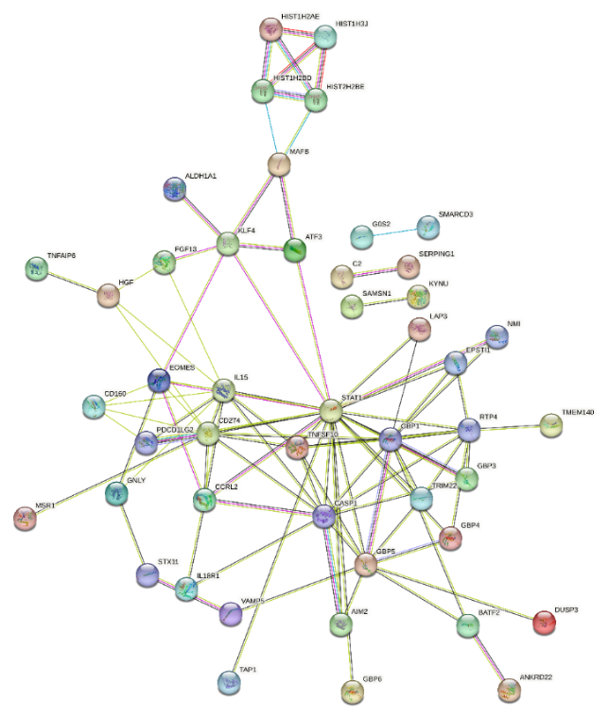
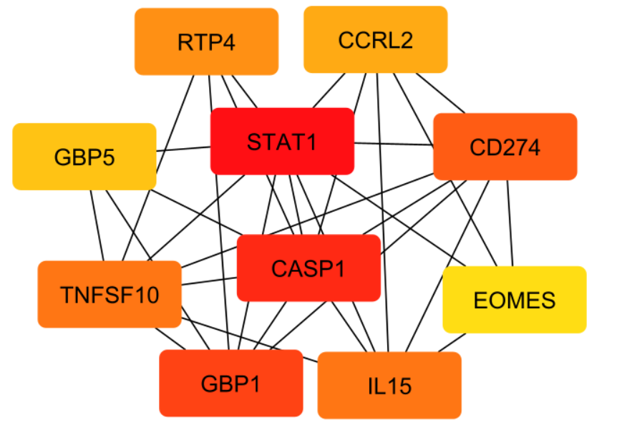
Protein – Protein Interaction Network
STRING 11.5
Cytoscape 2.1
Plugin : Cytohubba
Criterion : Degree
Total Nodes : 96
Edges : 97
Interaction Score : 0.4

Slide 9
Expression Level Comparison
Sl.no | Genes | LogFC TBDM | LogFC TB only
1. | STAT1 | 0.78 | 0.63
2. | CASP1 | 0.77 | 0.60
3. | GBP1 | 1.52 | 1.06
4. | CD274 | 1.96 | 1.01
5. | TNFSF10 | 0.85 | 0.57
6. | IL15 | 0.93 | 0.61
7. | RTP4 | 1.24 | 0.87
8. | CCRL2 | 0.99 | 0.71
9. | GBP5 | 1.39 | 0.97
10. | EOMES | -0.86 | -0.56
Cutoff :
p-value < 0.01
Log Fold Change > 0.5 (upregulated)
Log Fold Change < - 0.5 (downregulated)
Fold change of hub genes in TB only and TBDM groups

Slide 10
Literature on Novel Significant Genes
Genes | Research Conclusion
TNFSF10 | Genes related to apoptosis pathways, including TNFSF10, are more active in severe ATB patients than healthy individuals, potentially causing increased monocyte apoptosis in severe cases (Yi Wang Et al., 2023)
EOMES | Two studies demonstrate that EOMES drives the secretion of IFN-γ (Dejean Et al., 2019)
RTP4 | RTP4, a Biomarker Associated with Diagnosing Pulmonary Tuberculosis and Pan-Cancer Analysis (Li H Et al.,2023)

Slide 11
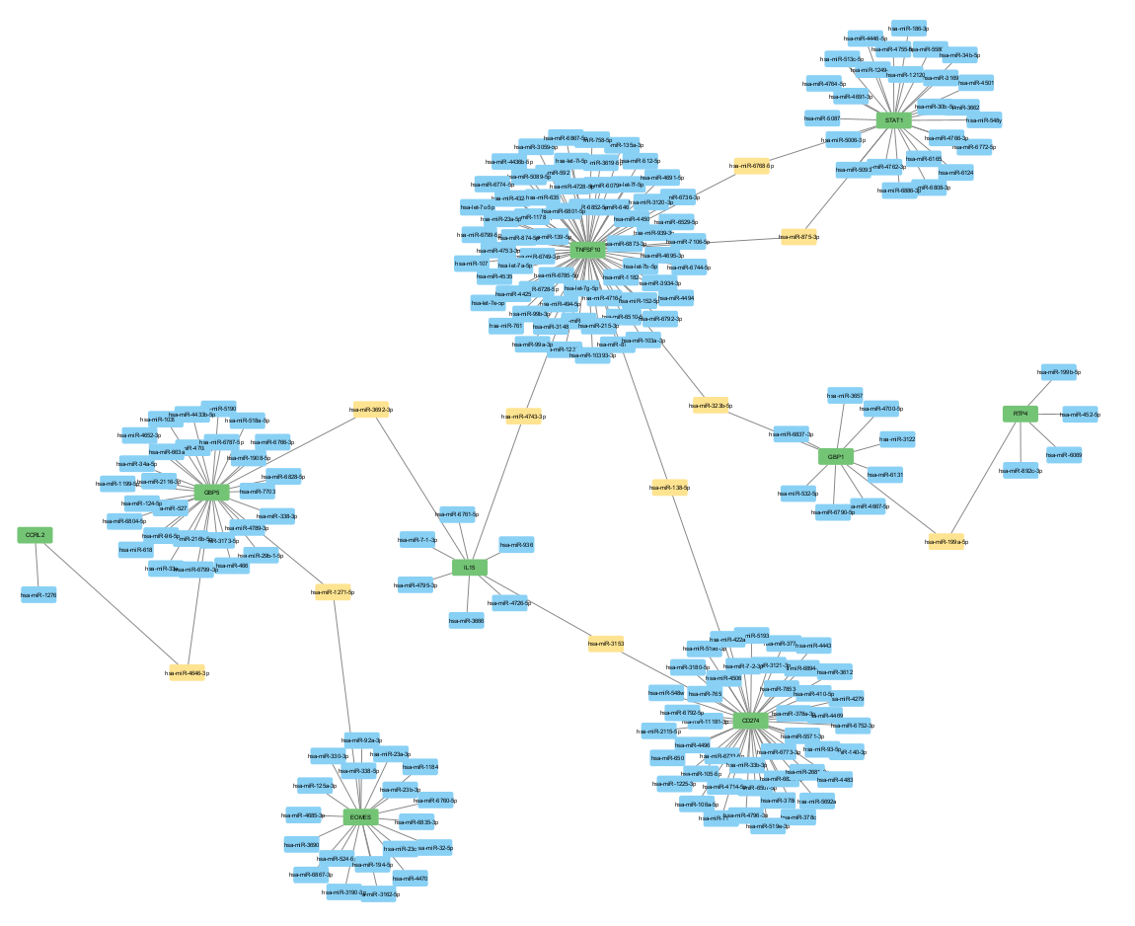
miRNA – Hub Gene Interaction Network
Significant miRNAs
- Hub genes
miRNA(s) | Target Genes
hsa-mir-1271-5p | GBP5, EOMES
hsa-mir-4646-3p | GBP1, CCRL2
hsa-mir-3692-3p | GBP5, IL15
hsa-mir-3153 | CD274, IL15
hsa-mir-4743-3p | IL15, TNFSF10
hsa-mir-138-5p | TNFSF10, CD274
hsa-mir-323b-5p | TNFSF10, GBP1
hsa-mir-199a-5p | GBP1, RTP4
hsa-mir-6768-5p, hsa-mir-875-3p | TNFSF10, STAT1
- miRNAs
- Sig. miRNAs
160 miRNAs interact with 9 hub genes with a target score of 0.90
10 significant miRNAs were identified

Slide 12
Conclusion
Hub Genes: On network construction, 10 hub genes were identified - STAT1, CASP1, GBP1, GBP5, TNFSF10, RTP4, CCRL2, CD274, IL15, and EOMES
Correlation of Hub Genes: The correlation of hub genes between the two groups were found to be positive. These genes were observed to be insignificant in the DM only group (p-value < 0.01, logFC > 0.5 and logFC < -0.5)
Novel (Potential) Biomarkers: TNFSF10 and EOMES could serve as novel potential biomarkers for ATB in both disease groups
miRNA Targets: Ten miRNAs were found to target at least two hub genes, and these could potentially serve as biomarkers for ATB

Slide 13
References
Dejean AS, Joulia E, Walzer T. The role of Eomes in human CD4 T cell differentiation: A question of context. Eur J Immunol. 2019 Jan;49(1):38-41. doi: 10.1002/eji.201848000. PMID: 30536524.
Gruarin, P., Maglie, S., De Simone, M., Haringer, B., Vasco, C., Ranzani, V., Bosotti, R. et al., Eomesodermin controls a unique differentiation program in human IL-10 and IFN-gamma coproducing regulatory T cells. Eur. J. Immunol. 2018.
Hernandez, A., Wang, Q.D., Schwartz, S.A., and Evers, B.M. (2001) Sensitization of human colon cancer cells to TRAIL mediated apoptosis. J Gastrointest Surg 5: 56–65
Li H, Zhou Q, Ding Z, Wang Q. RTP4, a Biomarker Associated with Diagnosing Pulmonary Tuberculosis and Pan-Cancer Analysis. Mediators Inflamm. 2023 Apr 26;2023:2318473. doi: 10.1155/2023/2318473. PMID: 37152371; PMCID: PMC10156460.
Mazzoni, A., Maggi, L., Siracusa, F., Ramazzotti, M., Rossi, M. C., Santarlasci, V., Montaini, G. et al., Eomes controls the development of Th17-derived (non-classic) Th1 cells during chronic inflammation. Eur. J. Immunol. 2018.

Slide 14

THANK YOU!

